Slide 1
Software Engineering Unit-V
Prepared by: Neha Tripathi

Slide 2
Software Reliability

Slide 3
Introduction
Reliability of a software product essentially denotes its trustworthiness or dependability. Alternatively, reliability of a software product can also be defined as the probability of the product working “correctly” over a given period of time.
It is obvious that a software product having a large number of defects is unreliable.
It is also clear that the reliability of a system improves, if the number of defects in it is reduced. However, there is no simple relationship between the observed system reliability and the number of latent defects in the system.
Notes:
For example, removing errors from parts of a software which are rarely executed makes little difference to the perceived reliability of the product. It has been experimentally observed by analyzing the behavior of a large number of programs that 90% of the execution time of a typical program is spent in executing only 10% of the instructions in the program. These most used 10% instructions are often called the core of the program. The rest 90% of the program statements are called non-core and are executed only for 10% of the total execution time. It therefore may not be very surprising to note that removing 60% product defects from the least used parts of a system would typically lead to only 3% improvement to the product reliability. It is clear that the quantity by which the overall reliability of a program improves due to the correction of a single error depends on how frequently is the corresponding instruction executed.

Slide 4
Continue…
Reliability of a product depends not only on the number of latent errors but also on the exact location of the errors.
Apart from this, reliability also depends upon how the product is used, i.e. on its execution profile.
If it is selected input data to the system such that only the “correctly” implemented functions are executed, none of the errors will be exposed and the perceived reliability of the product will be high.
On the other hand, if the input data is selected such that only those functions which contain errors are invoked, the perceived reliability of the system will be very low.

Slide 5
Reasons for software reliability being difficult to measure
• The reliability improvement due to fixing a single bug depends on where the bug is located in the code.
• The perceived reliability of a software product is highly observer-dependent.
• The reliability of a product keeps changing as errors are detected and fixed.

Slide 6
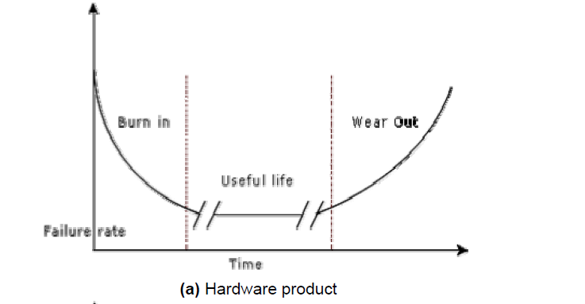
Hardware reliability vs. software reliability (Change in failure rate of a product)

Slide 7
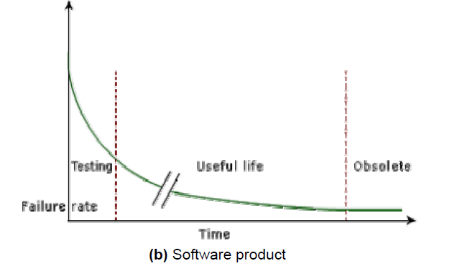
Continue…

Slide 8
Reliability metrics
There are six reliability metrics which can be used to quantify the reliability of software products.
Rate of occurrence of failure (ROCOF). ROCOF measures the frequency of occurrence of unexpected behavior (i.e. failures). ROCOF measure of a software product can be obtained by observing the behavior of a software product in operation over a specified time interval and then recording the total number of failures occurring during the interval.
• Mean Time To Failure (MTTF). MTTF is the average time between two successive failures, observed over a large number of failures It is important to note that only run time is considered in the time measurements, i.e. the time for which the system is down to fix the error, the boot time, etc are not taken into account in the time measurements and the clock is stopped at these times.
Mean Time To Repair (MTTR). Once failure occurs, some time is required to fix the error. MTTR measures the average time it takes to track the errors causing the failure and to fix them.

Slide 9
Continue….
• Mean Time Between Failure (MTBR). MTTF and MTTR can be combined to get the MTBR metric: MTBF = MTTF + MTTR. Thus, MTBF of 300 hours indicates that once a failure occurs, the next failure is expected after 300 hours. In this case, time measurements are real time and not the execution time as in MTTF.
• Probability of Failure on Demand (POFOD). Unlike the other metrics discussed, this metric does not explicitly involve time measurements. POFOD measures the likelihood of the system failing when a service request is made. For example, a POFOD of 0.001 would mean that 1 out of every 1000 service requests would result in a failure.
Availability. Availability of a system is a measure of how likely shall the system be available for use over a given period of time. This metric not only considers the number of failures occurring during a time interval, but also takes into account the repair time (down time) of a system when a failure occurs.

Slide 10
Classification of software failures
• Transient.
Transient failures occur only for certain input values while invoking a function of the system.
• Permanent.
Permanent failures occur for all input values while invoking a function of the system.
• Recoverable.
When recoverable failures occur, the system recovers with or without operator intervention.
• Unrecoverable.
In unrecoverable failures, the system may need to be restarted.
• Cosmetic.
These classes of failures cause only minor irritations, and do not lead to incorrect results

Slide 11
Thank you!

